Slide 1
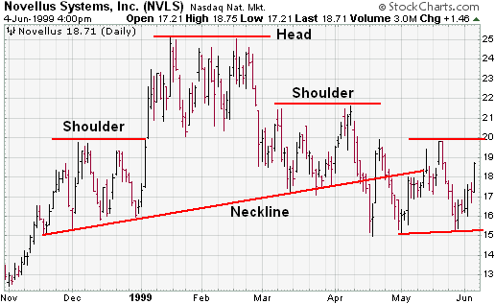
2 months before expiration:
Which it’s best time (and price) to trade options on financial markets?

Slide 2
The data
35 years of daily and weekly S&P 500 index data (all available for free)
25 years of daily data on options on S&P 500 (the most recent are for free)
Focus on the last expiration of each quarter (most important expiration)
140 quarters (samples) to train the model
Some simple indicators (mostly moving averages) and some proprietary indicators
So, the model once trained can work with data all available on the web for free (Google Finance, Yahoo Finance, …

Slide 3
The Model
4 independent regression models:
Guess the price upper limit
Guess the price lower limit
Guess the extent of the price movement
Guess the central point of the price movement
Any intersection of these two ranges is our target
Some Graph?

Slide 4
The fifth element
One indicator based upon main options open interests telling us how the current price level “challenges” the exposure of the biggest investors: how much they’re going to lose at the expiration date at that price.
These investors able to “push” and “pull” the market, to some extent; you can see clear samples of that when time is close options expirations).
When the price is out of our intersection, and this indicator, to be checked day by day through the 2 months, points in the directions of the intersection, that’s the right time to trade options.
Some graphs…
Samples: March 9th 2009, June 8th 2015,…

Slide 5
Model outcomes
This perfect scenario occurs in roughly 50% of analyzed samples
So, how much profit from analyzed samples?
Your can keep the whole profit from an OTM sold option sale, or lock in your profits from your hedged positions, so… choose the kind of trade you need, and just add money!
But the models and the indicator help very much in supporting the trading decisions even when you don’t get this “perfect” scenario

Slide 6
And it works also on any (much) liquid exchange traded asset!
Single Stocks, Forex, Commodities,…

